Slide 1
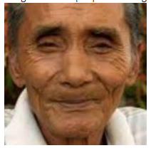
Age & Gender Detection
I don’t remember my date of birth!!!
Presented by Team 2 -
Bhawna (180010009)
Partiksha(180010020)

Slide 2
Problem Statement - Given an image, detect age and gender of the person.
Detecting age is a regression problem.
Activation function - reLU
Loss function - mae (mean absolute error)
Detecting gender is a classification problem.
Activation function - Sigmoid
Loss function - Binary cross entropy
Dataset - images named in format age_gender_someNumbers.jpg
Convolutional Neural Network is used for modelling the problem.
Tensorflow is used for implementing.
openCV is used for image processing.

Slide 3
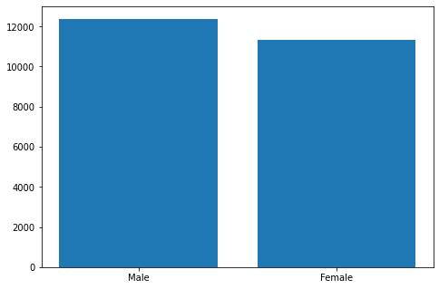
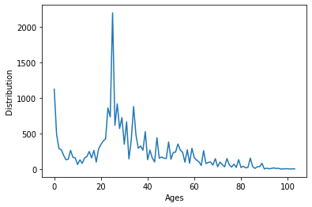
Data Distribution- (https://www.kaggle.com/jangedoo/utkface-new)

Slide 4
Layers -
reLu
LAYER-4
Predicted-Age
output_1
INPUT
LAYER-1
LAYER-2
LAYER-3
LAYER-5
Predicted-Gender
output_2
Sigmoid

Slide 5
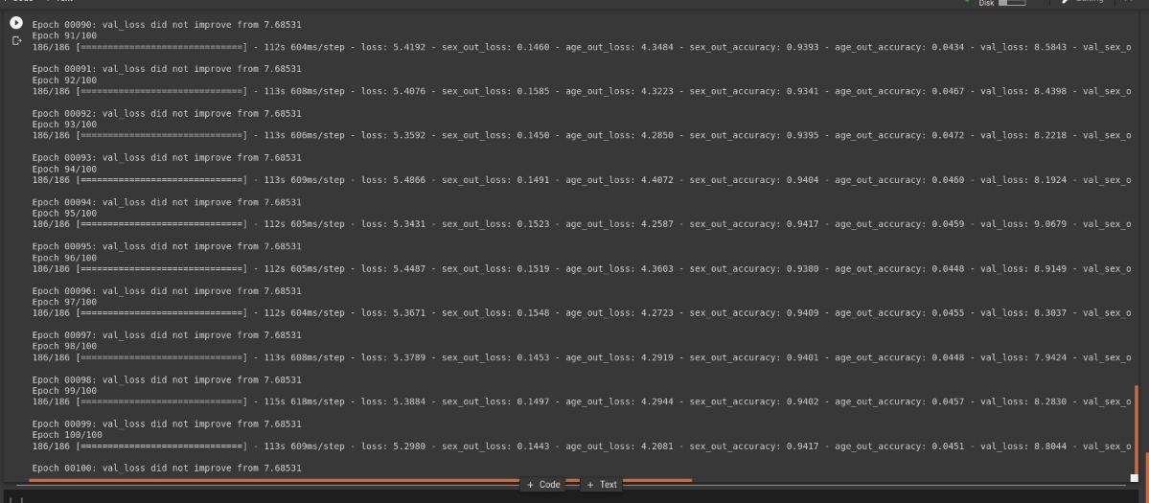
Training snapshot-

Slide 6
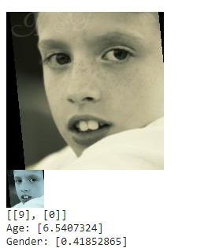
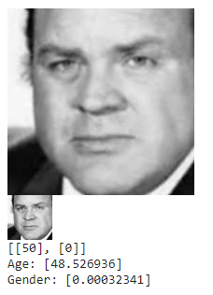
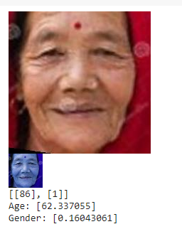
Output samples -

Slide 7
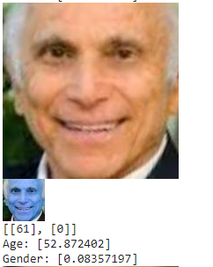
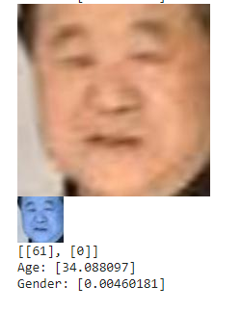
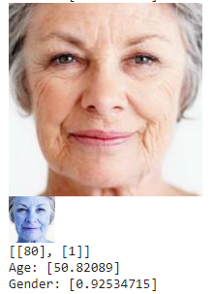
Some more...

Slide 8
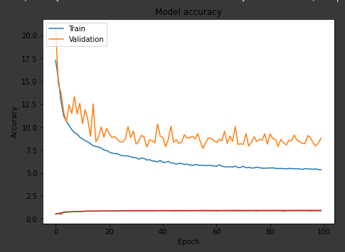
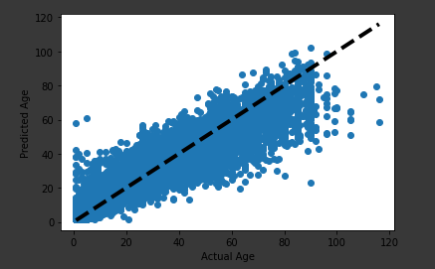
Model evaluation -

Slide 9
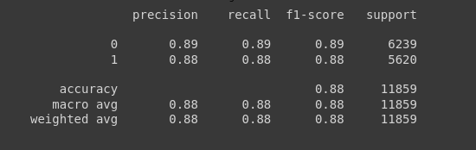
Accuracy = no. of features classified correctly / no. of features
Precision(P) = True positive / (True positive + False positive)
Recall(R) = True positive / (True positive + False negative)
Classification Report -
Accuracy - 88%
F1 Score = 2*P*R / (P + R)

Slide 10
Major challenges faced -
There are some images in the dataset which are cropped proplerly but some are not, which are making wrong predictions.
Some of the images are blurry in the dataset, which causes noise in the network.
Some of the images are not taken in proper light, hence our model ended up in wrong prediction.
In some of the images, hair are cropped (or not visible), which causes problem in predicting gender.
Number of epochs are taken 100 because of time limitation and low network bandwidth.

Slide 11
Scopes of improvement -
The minima where we reached might be a local minima. By increasing number of epochs, we can confirm this.
Dataset can be improved by cropping the images properly.
Some images are blurry which provides some scope of improvement.
Number of hidden layers can be increased for more complexity (overfitting should be taken care of).
Dataset is not uniformly distributed.
There are more images of persons of age in range 20-30.
There are more images of males than females. But there is not much difference in their number.

Slide 12
THANK YOU :)
No problem!
Let me click your photo!!
Your age is 75 (approx!!).

Slide 13
References -
Lecture Slides
https://www.tensorflow.org/learn
https://towardsdatascience.com/facial-data-based-deep-learning-emotion-age-and-gender-prediction-47f2cc1edda7
Dataset - https://www.kaggle.com/jangedoo/utkface-new

Slide 14
Contribution towards the project -
Bhawna - I have mainly worked on the detection of age problem. I have decided its activation and loss function.
Partiksha - I have worked on the detection of gender prediction and achieved an accuracy of 88%.
We have worked on google collab and had google meet meetings regularly so that we both can contribute equally.

